Slide 1
UNIT III – OpenFlow, Programmability and the Management Interface
UNIT I – SESSION 1
SESSION 2
OpenFlow 1.0 and OpenFlow Basics-
Ports and Port Queues
Flow Table
Packet Matching
Actions and Packet Forwarding
Messaging Between Controller and Switch
Reference: Ref. 1, Ch. 5.3 to 5.3.5

Slide 2
Ports and Ports Queue
The OpenFlow specification defines the concept of an OpenFlow port. An OpenFlow V.1.0 port corresponds to a physical port.
For many years, sophisticated switches have supported multiple queues per physical port. These queues are generally served by scheduling algorithms that allow the provisioning of different quality of service (QoS) levels for different types of packets.
OpenFlow embraces this concept and permits a flow to be mapped to an already defined queue at an output port.
Thus, the output of a packet on port N may include specifying onto which queue on port N the packet should be placed.

Slide 3
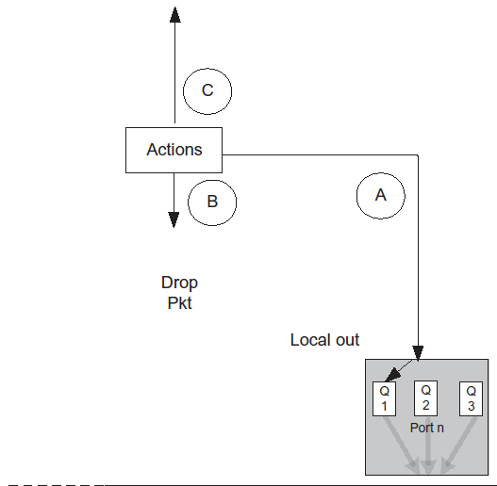
Ports and Ports Queue

Slide 4
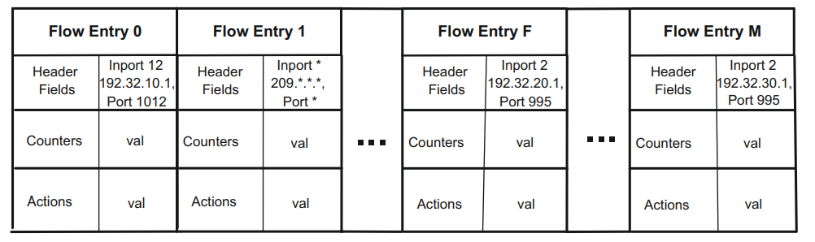
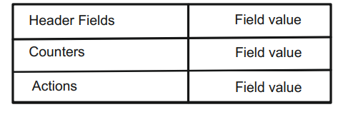
Open Flow Ver 1.0 Flow Table
Basic Flow Entry

Slide 5
Flow Table
The flow table lies at the core of the definition of an OpenFlow switch.
We depict a generic flow table in Figure.
A flow table consists of flow entries, a flow entry consists of header fields, counters, and actions associated with that entry.
The header fields are used as match criteria to determine whether an incoming packet matches this entry. If a match exists, the packet belongs to this flow.
The counters are used to track statistics relative to this flow, such as how many packets have been forwarded or dropped for this flow.
The actions fields prescribe what the switch should do with a packet matching this entry.

Slide 6
Packet Matching
When a packet arrives at the OpenFlow switch from an input port, it is matched against the flow table to determine whether there is a matching flow entry.
The following match fields associated with the incoming packet may be used for matching against flow entries:
• Switch input port • VLAN ID • VLAN priority • Ethernet source address • Ethernet destination address • Ethernet frame type • IP source address • IP destination address • IP protocol • IP Type of Service (ToS) bits • TCP/UDP source port • TCP/UDP destination port.
These 12 match fields are collectively referred to as the basic 12-tuple of match fields.
The flow entry’s match fields may be wildcarded using a bit mask, meaning that any value that matches on the unmasked bits in the incoming packet’s match fields will be a match.

Slide 7
Packet Matching
Flow entries are processed in order, and once a match is found, no further match attempts are made against that flow table.
For this reason, it is possible for there to be multiple matching flow entries for a packet to be present in a flow table.
Only the first flow entry to match is meaningful; the others will not be found, because packet matching stops upon the first match.
The ONF has defined three different types of conformance in its V.1.0 conformance-testing program.
The three levels are full conformance, meaning all 12 match fields are supported; layer two conformance, when only the layer 2 header field matching is supported; and, finally, layer three conformance, when only layer 3 header field matching is supported.

Slide 8
If the end of the flow table is reached without finding a match, this is called a table miss. In the event of a table miss in V.1.0, the packet is forwarded to the controller.
If a matching flow entry is found, the actions associated with that flow entry determine how the packet is handled.
The most basic action prescribed by an OpenFlow switch entry is how to forward this packet.
A good abstraction hides the details of the thing being abstracted while still permitting sufficiently fine-grained control to accomplish the needed tasks.
As richer functionality is added in later versions of the OpenFlow protocol, we will see that the specification outpaces the reality of today’s hardware.
At that point, it is no longer providing a clean abstraction for current implementations but specifying behavior for switching hardware that has yet to be built

Slide 9
Actions and Packet Forwarding
The required actions that must be supported by a flow entry are to either output (forward) or drop the matched packet.
The most common case is that the output action specifies a physical port on which the packet should be forwarded.
There are, however, five special virtual ports defined in V.1.0 that have special significance for the output action. They are LOCAL, ALL, CONTROLLER, IN_PORT, and TABLE.
LOCAL is used when OpenFlow messages from the controller are received on a port that is receiving packets switched by the OpenFlow data plane.
LOCAL indicates that the packet needs to be processed by the local OpenFlow control software.

Slide 10
ALL is used to flood a packet out all ports on the switch except the input port. This provides rudimentary broadcast capability to the OpenFlow switch.
CONTROLLER indicates that the switch should forward this packet to the OpenFlow controller.
IN_PORT instructs the switch to forward the packet back out of the port on which it arrived.
Effectively, IN_PORT normally creates a loopback situation, which could be useful for certain scenarios.
One scenario in which this is useful is the case of an 802.11 wireless port. In this case, it is quite normal to receive a packet from that port from one host and to forward it to the receiving host via the same port.
This needs to be done very carefully so as not to create unintended loopback situations.
Thus the protocol requires explicit stipulation of this intent via this special virtual port.

Slide 11
Another instance when IN_PORT is required is edge virtual bridging (EVB).
EVB defines a reflective relay service between a physical switch in a data center and a lightweight virtual switch within the server known as a virtual edge port aggregator (VEPA).
The standard IEEE 802.1Q bridge at the edge of the network will reflect packets back out the port on which they arrive to allow two virtual machines on the same server to talk to one another.
This reflective relay service can be supported by the IN_PORT destination in OpenFlow rules.
Finally, there is the TABLE virtual port, which only applies to packets that the controller sends to the switch.
Such packets arrive as part of the PACKET_OUT message from the controller, which includes an action list.
This action list will generally contain an output action, which will specify a port number.

Slide 12
These two options are depicted in the two Y paths shown in Figure. There are two additional virtual ports, but support for these is optional in V.1.0.
The first is the NORMAL virtual port. When the output action forwards a packet to the NORMAL virtual port, it sends the packet to the legacy forwarding logic of the switch.
We contrast this with the LOCAL virtual port, which designates that the packet be passed to the local OpenFlow control processing.
Conversely, packets for which matching rules indicate NORMAL as the output port will remain in the ASIC to be looked up in other forwarding tables that are populated by the local (non-OpenFlow) control plane.
The remaining virtual port is FLOOD. In this case, the switch sends a copy of the packet out all ports except the ingress port.

Slide 13
Messaging between Controller and Switch
The messaging between the controller and switch is transmitted over a secure channel.
This secure channel is implemented via an initial TLS connection over TCP. (Subsequent versions of OpenFlow allow for multiple connections within one secure channel.)
If the switch knows the IP address of the controller, the switch will initiate this connection.
Each message between controller and switch starts with the OpenFlow header. This header specifies the OpenFlow version number, the message type, the length of the message, and the transaction ID of the message.
The various message types in V.1.0 fall into three general categories: symmetric, controller-switch, and async.

Slide 14
Messaging between Controller and Switch
Symmetric messages may be sent by either the controller or the switch without having been solicited by the other.
The HELLO messages are exchanged after the secure channel has been established to determine the highest OpenFlow version number supported by the peers.
The protocol specifies that the lower of the two versions is to be used for controller-switch communication over this secure channel instance.
ECHO messages are used by either side during the life of the channel to ascertain that the connection is still alive and to measure the current latency or bandwidth of the connection.
The VENDOR messages are available for vendor-specific experimentation or enhancements

Slide 15
Messaging between Controller and Switch
Async messages are sent from the switch to the controller without having been solicited by the controller.
The PACKET_IN message is the way the switch passes data packets back to the controller for exception handling.
Control plane traffic will usually be sent back to the controller via this message.
The switch can inform the controller that a flow entry is removed from the flow table via the FLOW_REMOVED message.
PORT_STATUS is used to communicate changes in port status, whether by direct user intervention or by a physical change in the communications medium itself.
Finally, the switch uses the ERROR message to notify the controller of problems.

Slide 16
Messaging between Controller and Switch
Controller-switch is the broadest category of OpenFlow messages.
They can be divided into five subcategories: switch configuration, command from controller, statistics, queue configuration, and barrier.
The switch configuration messages consist of a unidirectional configuration message and two request-reply message pairs. The controller uses the unidirectional message, SET_CONFIG to set configuration parameters in the switch.
We see the SET_CONFIG message sent during the initialization phase of the controller-switch dialogue.
The controller uses the FEATURES message pair to interrogate the switch about which features it supports.
Similarly, the GET_CONFIG message pair is used to retrieve a switch’s configuration settings

Slide 17
There are three messages comprising the command from controller category.
The controller uses PACKET_OUT to send data packets to the switch for forwarding out through the data plane.
The controller modifies existing flow entries in the switch via the FLOW_MOD message.
PORT_MOD is used to modify the status of an OpenFlow port.
Statistics are obtained from the switch by the controller via the STATS message pair.
The BARRIER message pair is used by the controller to ensure that a particular OpenFlow command from the controller has finished executing on the switch.
The switch must complete execution of all commands received prior to the BARRIER_REQUEST before executing any commands received after it, and the switch notifies the controller of having completed such preceding commands via the BARRIER_REPLY message sent back to the controller.

Slide 18
The QUEUE_GET_CONFIG_REQUEST and QUEUE_GET_CONFIG_REPLY message pair is the mechanism by which the controller learns from the switch how a given queue is configured.
With this information, the controller can intelligently map certain flows to specific queues to achieve desired QoS levels.
In the event that the HELLO protocol detects a loss of the connection between controller and switch, the V.1.0 specification prescribes that the switch should enter emergency mode and reset the TCP connection.
At this time all flows are to be deleted except special flows that are marked as being part of the emergency flow cache.

